Slide 1
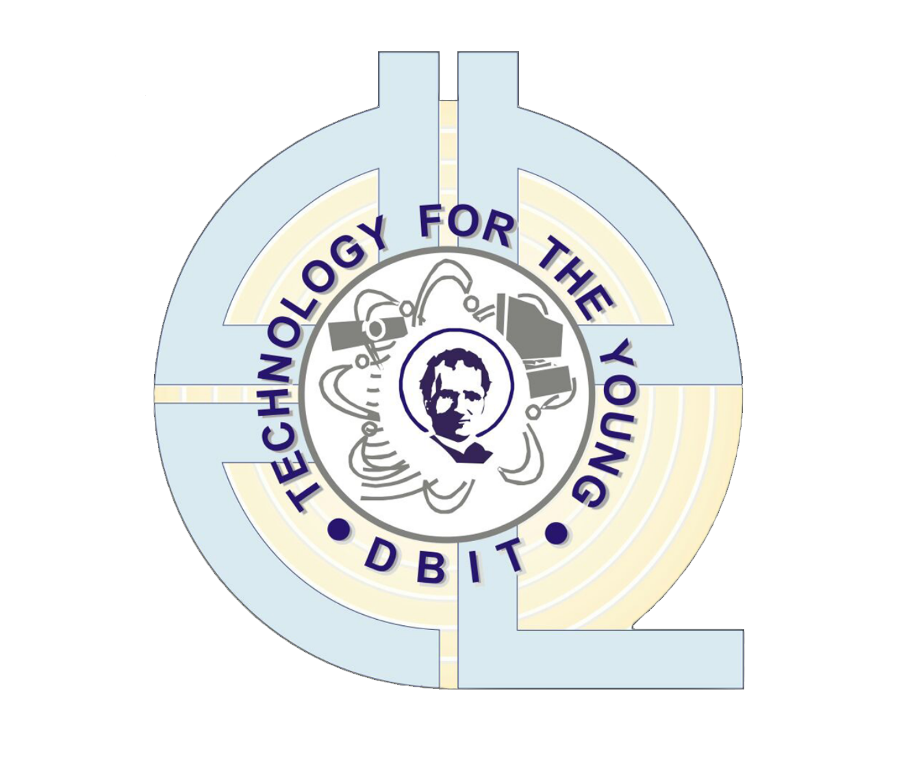
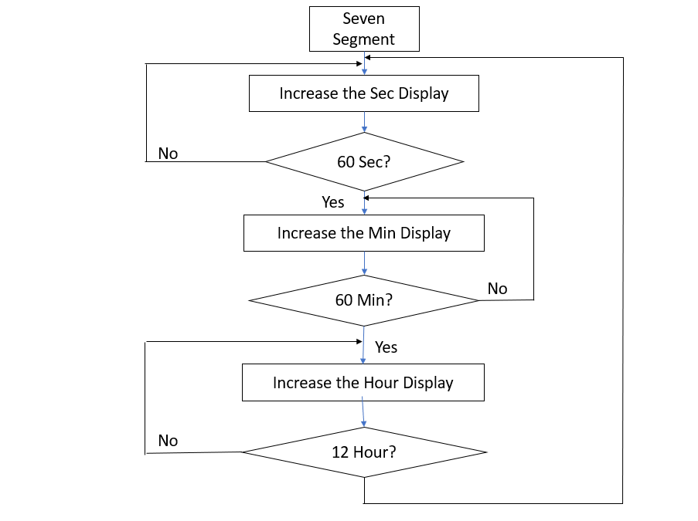
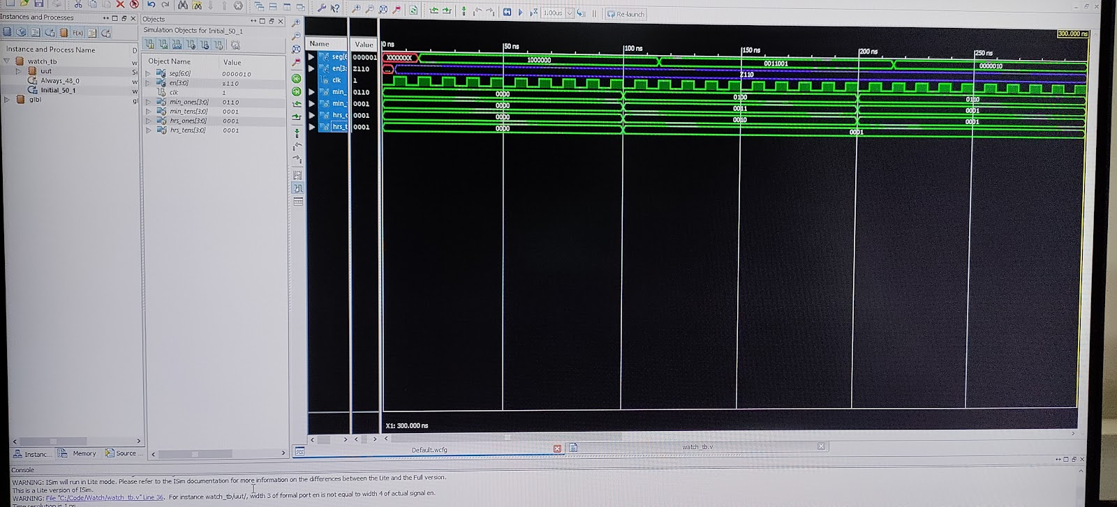
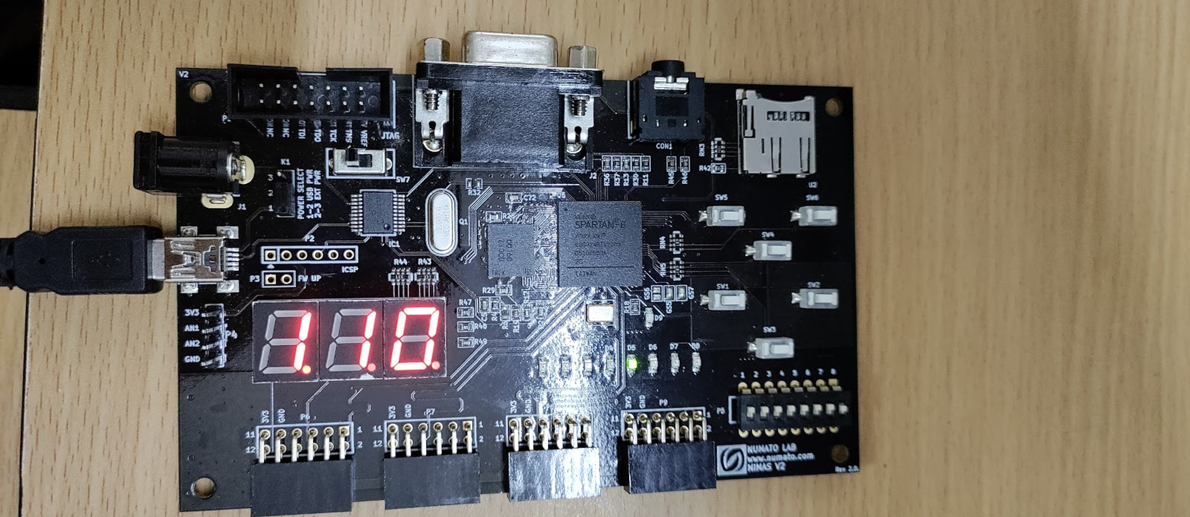
Name of Category/Domain/Group: Product Development/Sustainability
Digital Watch
< Mohd Raza , Aditya Jadhav, Himanshu Jogi, Mayuri Kadam > Prof. Lakshmi Iyer, Prof. Ankur G, Dr. Sudhakar Mande
Department of Electronics & Telecommunication Engineering,
Don Bosco Institute of Technology, Mumbai- 400070
2023-2024
Abstract
Architecture / Design Detail
Results
The project will involve the design and development of a custom digital logic circuit that can accurately track time, update the display, and handle user input for setting the time and date.
Objectives
Methods/Algorithm/Application Description
Future Scope
Customizability: - Ability to customize the functionality and appearance of digital watch
High performance :- FPGAs offer high performance computing capabilities, enabling the digital watch to execute timekeeping function accurate and efficiently.
Stopwatch Feature: The FPGA board can be programmed to implement a stopwatch feature, which can be useful in various applications.
Portability: The digital clock implementation with FPGA board can be applied directly in various designs based on FPGA, making it a portable solution for different applications.
Industrial Applications: Time and attendance systems, industrial automation, and control systems.
Security: The project can be enhanced with security features such as encrypted communication and secure boot.
TE Mini Project 2023-24

